Slide 1
JavA Trivia Game
By Ted Smith III

Slide 2
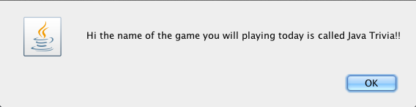
Topic
My term project is a GUI study game called, “Jave Trivia!!!”

Slide 3
Instructions
The user must input his/her name and then press okay.
The player will play the game by clicking on the buttons to reveal the questions.
To answer the questions players most choose the option corresponding to the given answer.
After all questions are answered, the player must press the “I’m done!!” button to find out if they won or not.

Slide 4
How to Win
The player needs to score at least 300 points to win.
The player receives points shown on the button that he/she click on if he/she answers the question shown correctly.
The player loses half the points shown on the button the he/she click on if he/she answers the question shown incorrectly.

Slide 5
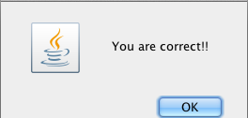
That’s Correct!!

Slide 6

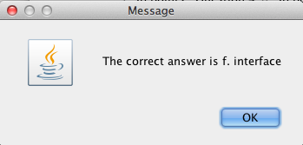
You Are Incorrect!!

